Slide 1
Pulsed Neutron Source: Summary and Plans
Jingbo Wang - South Dakota School of Mines & Technology
Notes:
Add DUNE logo

Slide 2
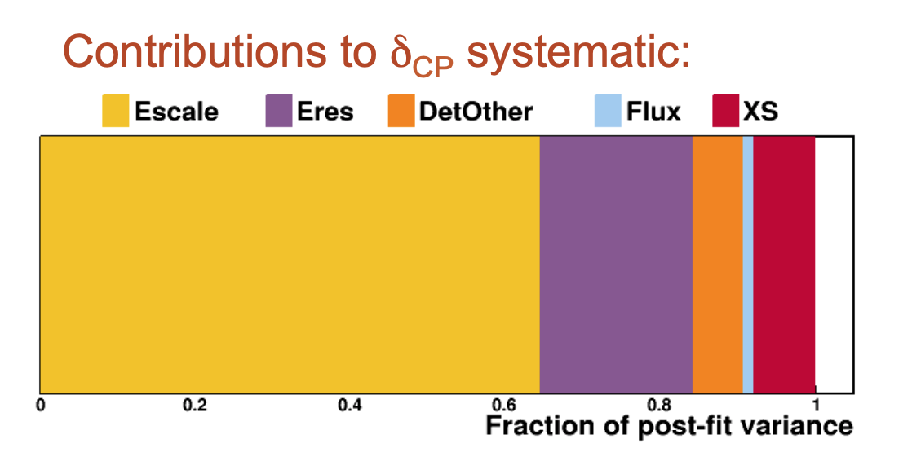
Introduction
Energy scale is the major detector
uncertainty remaining after ND inputs*
Will neutrinos measured
in 202x have the same
Energy scale systematic as
anti-neutrinos in 202x+7?
Need to prove that it is so.
Our competition will.
assumes 2% systematic
shift in energy scale
(E.Worcester, ND Review June 2019)
This assumes the energy scale
shift is constant over 7 years
*Includes full FD simulation and automated reconstruction; parametrized ND samples; detailed treatment of systematics

Slide 3
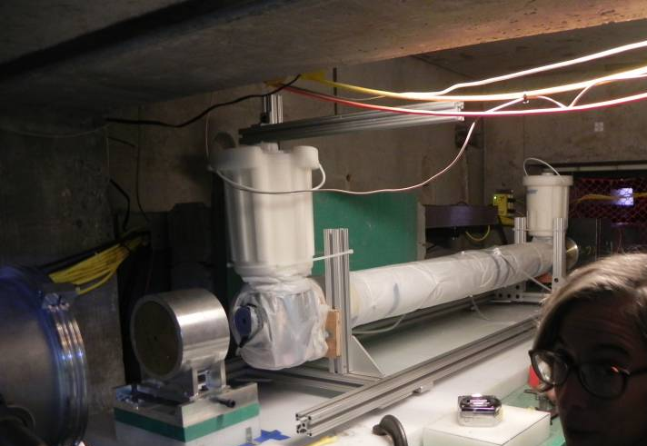
Verification of 57 keV anti-resonance
Argon Resonant Transport Interaction Experiment (ARTIE) measured the neutron total cross-section around 57 keV at LANL
The result has verified the existence of the anti-resonance at 57 keV
Completed analysis of systematic uncertainties, and paper is in publishable format.
ARTIE liquid argon target setup
ARTIE preliminary

Slide 4
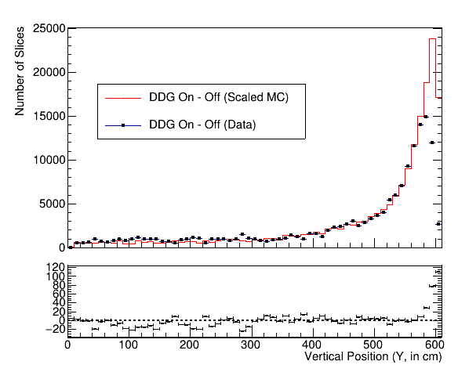
Verifying the Neutron Transport Model
Plot shows the vertical position of slices (3D clusters) after subtracting DDG Off data from DDG On data along with the MC fit
DDG deployed at the top; Expect to see more activity at higher Y
Good agreement between data and MC, except at the top; Disagreement seen in both DDG off and on data
Existence of long, non-exponential “tail” of neutrons penetrating deep into the detector verified
Fig. Plot with data and the fit. Number of slices (3D-clusters) on Y-axis and vertical position on X-axis.
Note: Also see the machine-learning-based analysis result (done by L. Uboldi and P. Sala, CERN)

Slide 5
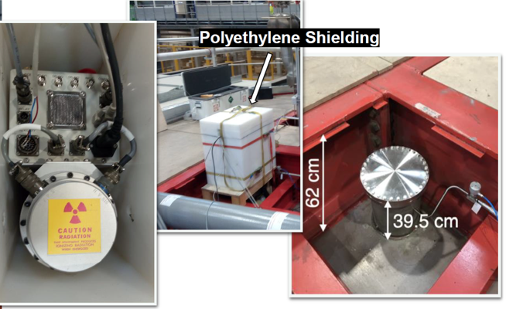
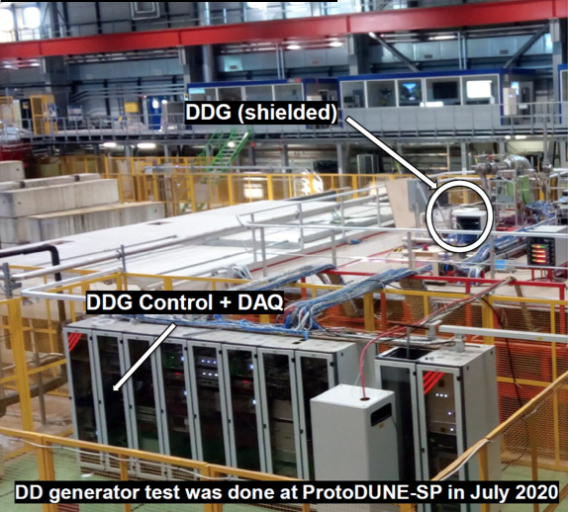
What we learned from the PD1 run
The DDG neutron shielding requirements were verified. Less that we anticipated initially
Gamma contamination was an issue that will require reflector and shield design changes
Yields without a heavy and complex moderator were not so bad. System can actually be somewhat portable and may not need to buy many fixed units.
Gained experience in running

Slide 6
Single capture is sensitive to energy scale
LArsoft full reconstruction done with ProtoDUNE-SP geometry
Simulate single neutron captures at three different positions
Point source of gamma cascades were generated at 0.5 m, 1 m and 2 m from the APA
6 ms electron lifetime, no noise, no background, no correction on lifetime or recombination

Slide 7
Statistical Toy MC

Slide 8
Preferred locations for Vertical Drift module
Simulation done with Vertical-Drift like geometry
Three PNS systems at ideal locations can cover most of the TPC volume
We propose these location for the vertical drift module.

Slide 9
Backup

Slide 10
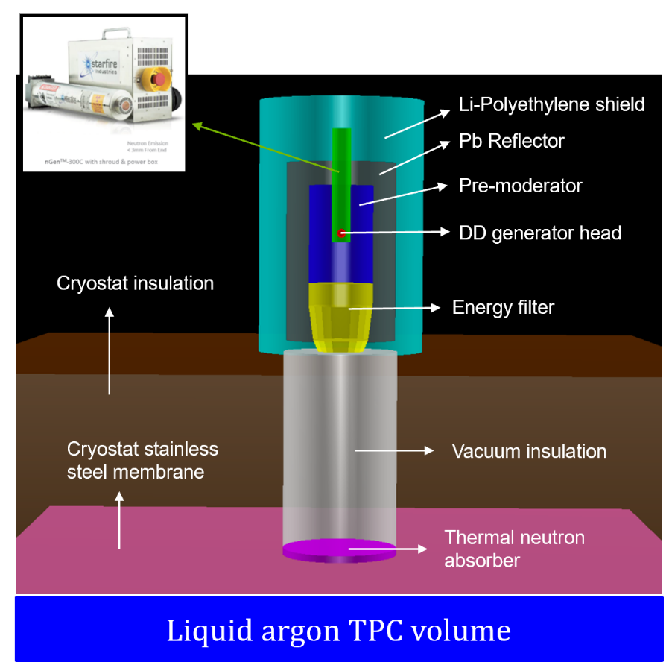
PNS for Calibration
Neutrons can travel long distances in liquid argon
Fractional energy loss per scatter is only 4.8%
~30m scattering length at 57 keV anti-resonance
Neutron captures on ⁴⁰Ar (99.6%) release 6.1 MeV gamma cascade
n + ⁴⁰Ar = ⁴¹Ar + 6.1 MeV
External deployment: no need to open the cryostat
Wide coverage: one external source covers 1/3 of the DUNE far detector module
Adjustable neutron yield, pulse width and rate
Frequent calibration runs allowed

Slide 11
Lessons Learned from PD-I
DD generator pulse rate was too high for DAQ
The minimum pulse rate of the generator was 250 Hz, well-above the rate that the DAQ system can handle. The 250 Hz rate was rescaled to selected several pulses per second to trigger the DAQ. All the remaining pulses were present as background
Capture signals were contaminated by external gammas
Neutron shield was provided by polyethylene no gamma shield. The observed signals in the TPC was contaminated by 2.2 MeV external gammas (mostly from n-capture on the shield)
Capture yield was limited by nonideal deployment location
Corner feedthrough (PD-1): footprint was close to the edge of the active TPC. neutron capture yield inside the active TPC is 0.11%

Slide 12
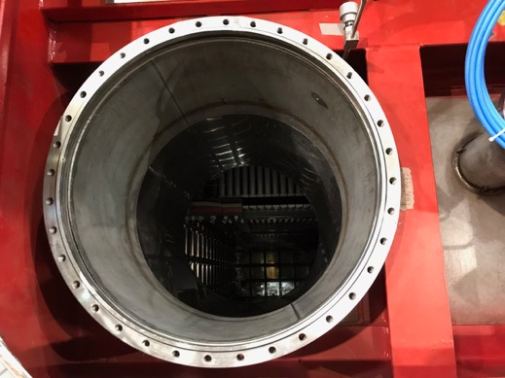
Possible Source Locations in PD-II
On top of feedthrough (footprint within active TPC, different from the one used in PD-I)
Inside of feedthrough
On top of manhole
Inside manhole
Beam plug

Slide 13
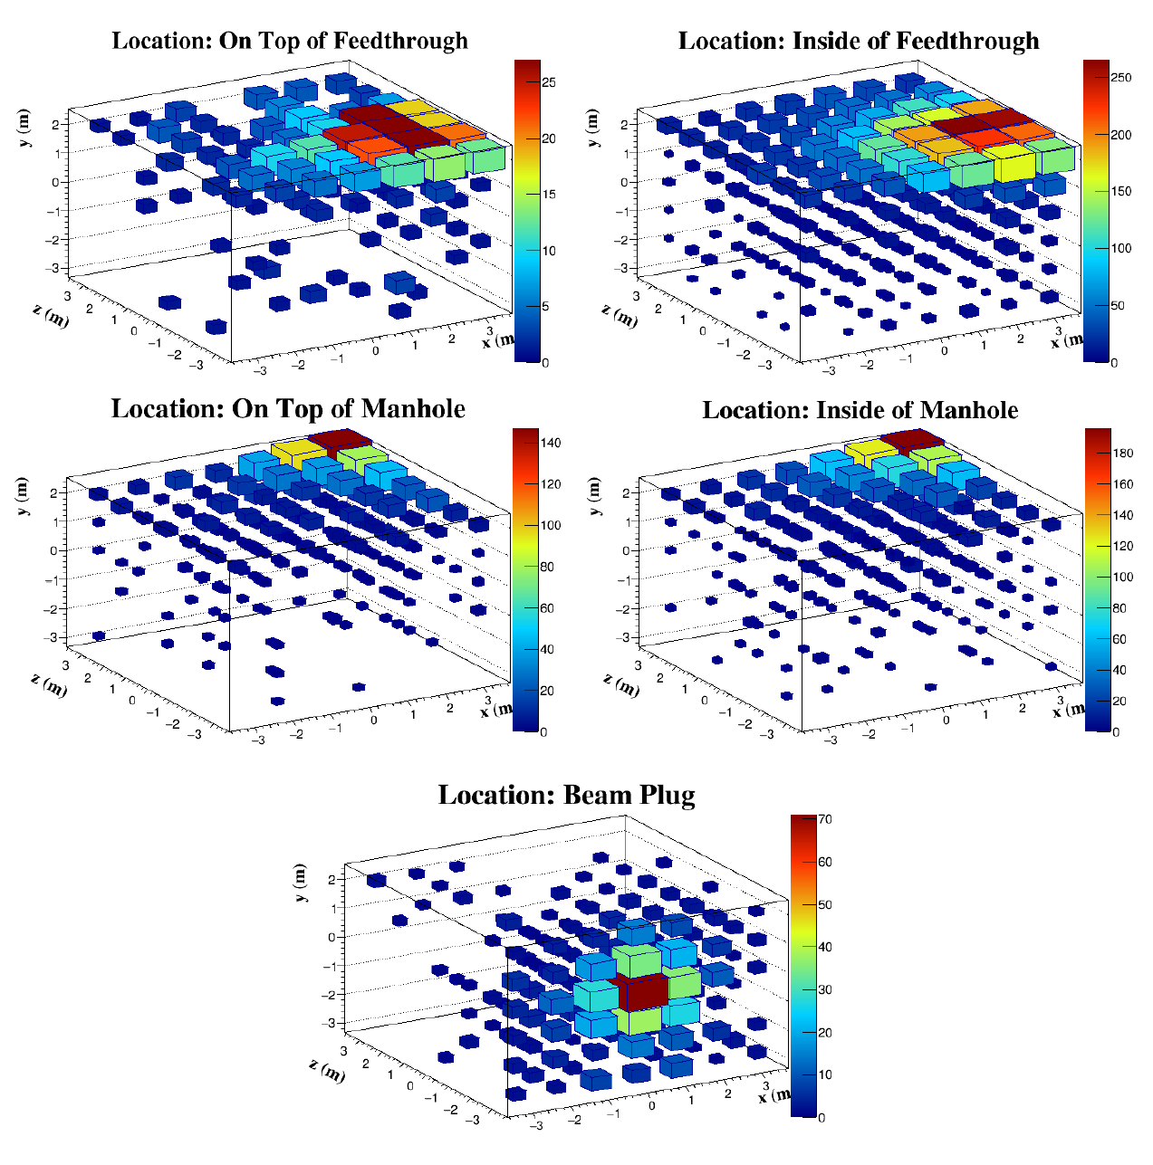
Coverage Simulation for PD-II
Simulated 10⁵ DD neutrons for each port location
Neutron capture yield is significantly improved compared to the 0.11% yield in PD-I
1 m³ Voxel with >1 neutron capture

Slide 14
What to do in PD-II
Main goal: make improvements to acquire high quality data with better signal-to-noise allowing detailed analysis
Modify the LANL DD generator
Detach the electronics box to allow more space for moderator optimization
Upgrade the firmware to reduce the minimum pulse rate from 250 Hz to 1 Hz
Improve the shielding configuration
Use borated polyethene for more efficient neutron shield
Use lead shield to reduce external gamma contamination
Test at better deployment locations
Beam plug
Manhole

